Slide 1
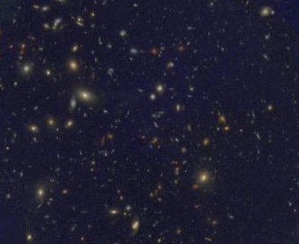


Analyzing Dust in Distant Galaxies
Sarah Saavedra
Dr. Allison Noble
Alex Pigarelli, Patrick Kamieneski, Sebastian Montaño
HST and VLT Image of a Distant Galaxy Cluster
Arizona Space Grant Statewide Symposium
20 April 2024

Slide 2
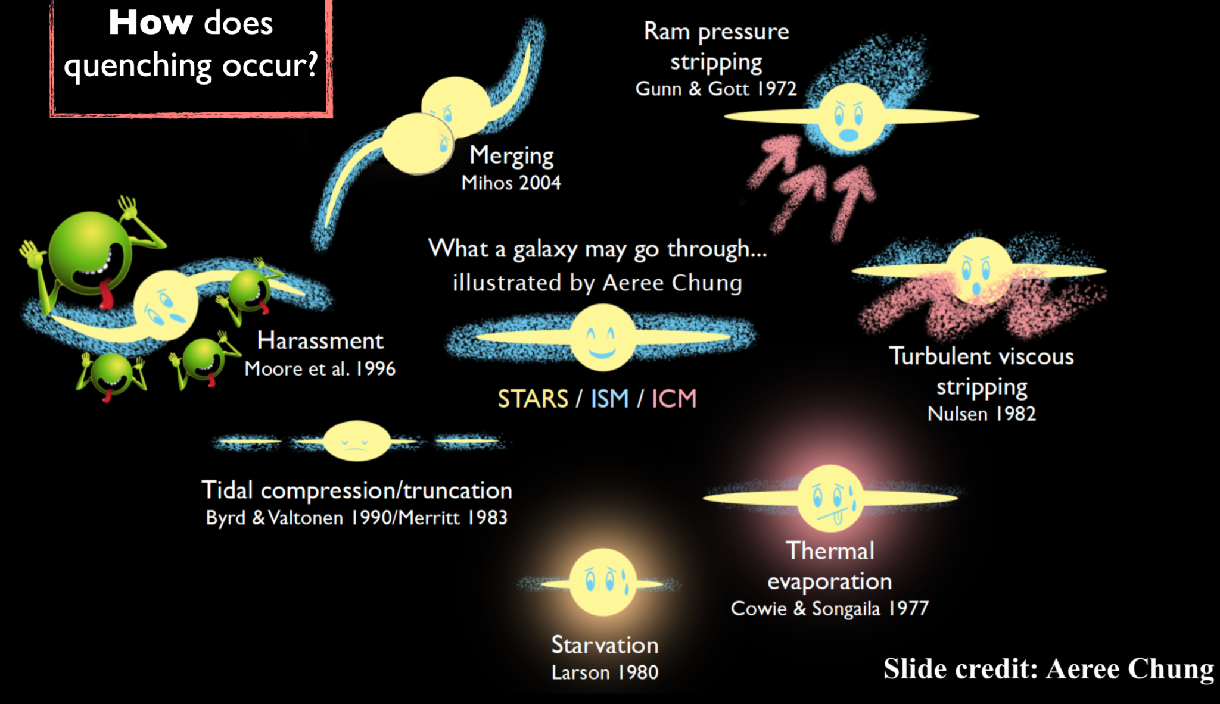
Science Goals
How is galaxy evolution impacted by the environment in which a galaxy resides?
Why do galaxies stop forming
stars?
Credit: Aeree Chung
Notes:
We can gain insight by comparing the sizes of a galaxy’s stellar, gas, and dust components. Molecular gas (CO) is indicative of future star formation, and the dust component is heated by newborn stars.

Slide 3
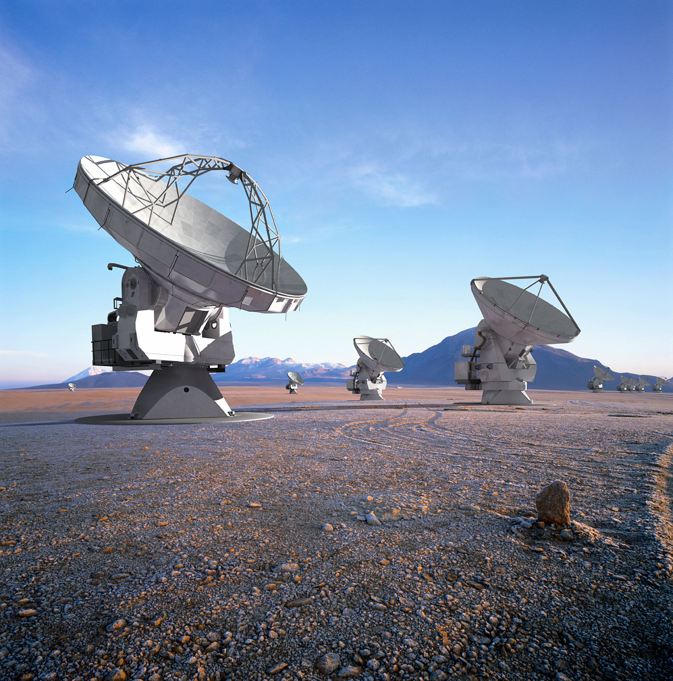
Observations
Dust emission is observed at 350 GHz
  ALMA Radio Telescope
  Heated by newborn stars
Three clusters at redshift of 1.63
  About 10 billion years ago, when star formation in the Universe peaked
Credit: ALMA (ESO/NAOJ/NRAO)/L. Calçada (ESO)/H. Heyer (ESO)/H. Zodet (ESO)

Slide 4
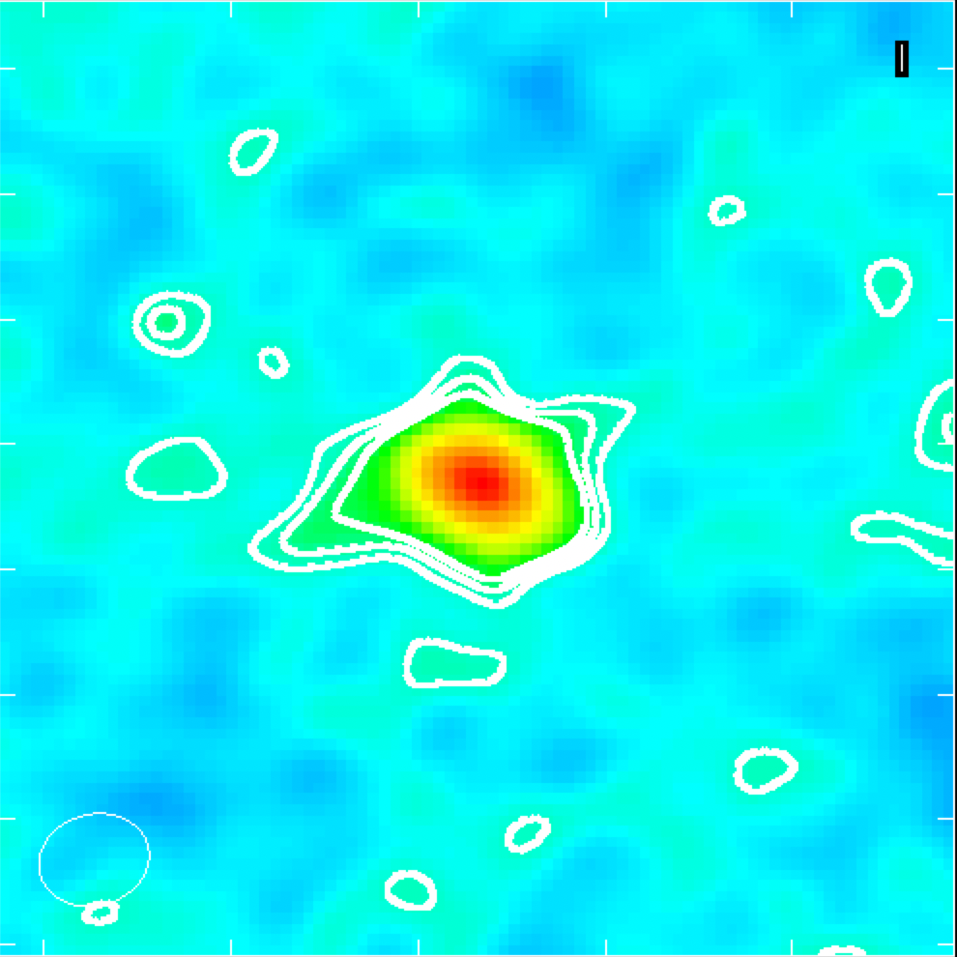
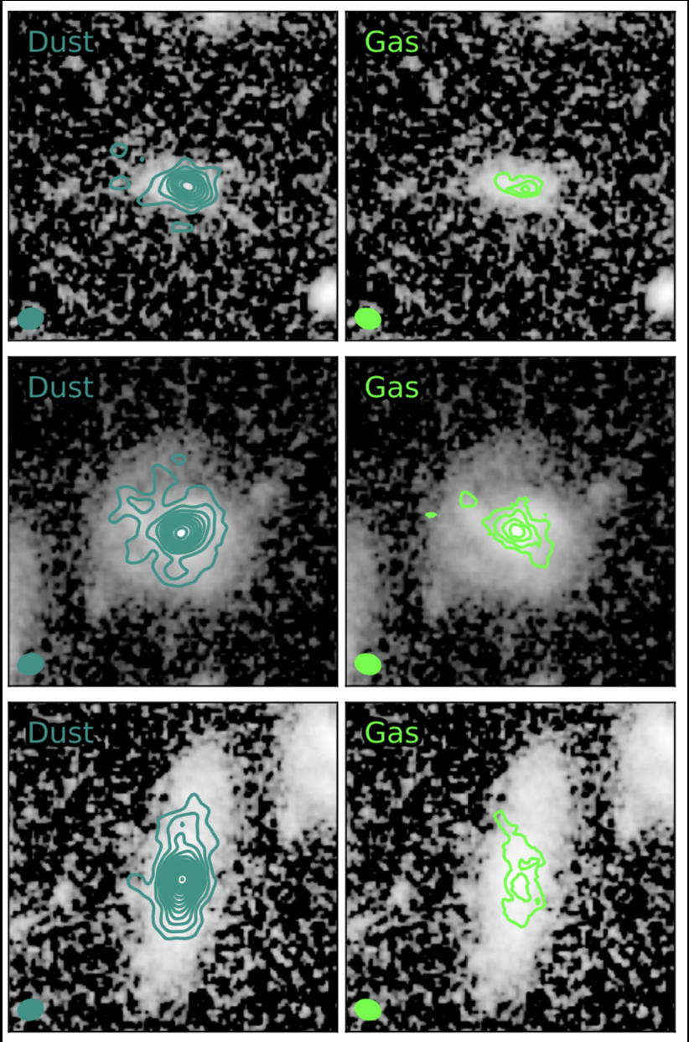
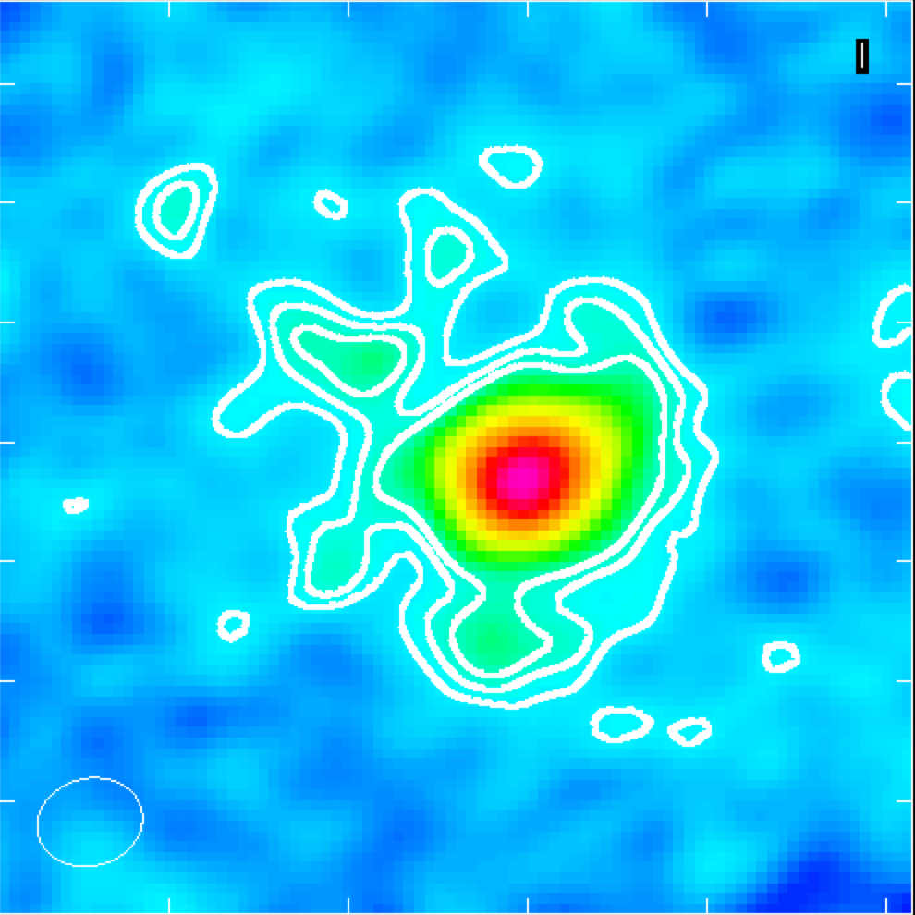
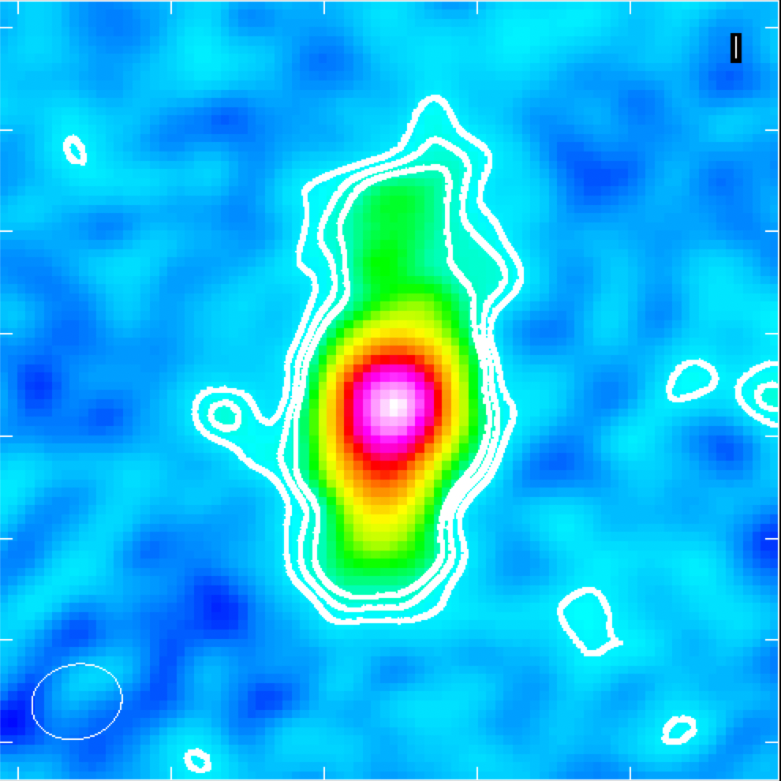
Observations
Dust Emission
Dust Contour
Gas
Contour
Cluster galaxies have a large range of fluxes, position angles, and sizes
Important to find a consistent measurement method for all kinds of galaxies
ALMA
HST
HST
Notes:
### change the labels ####

Slide 5
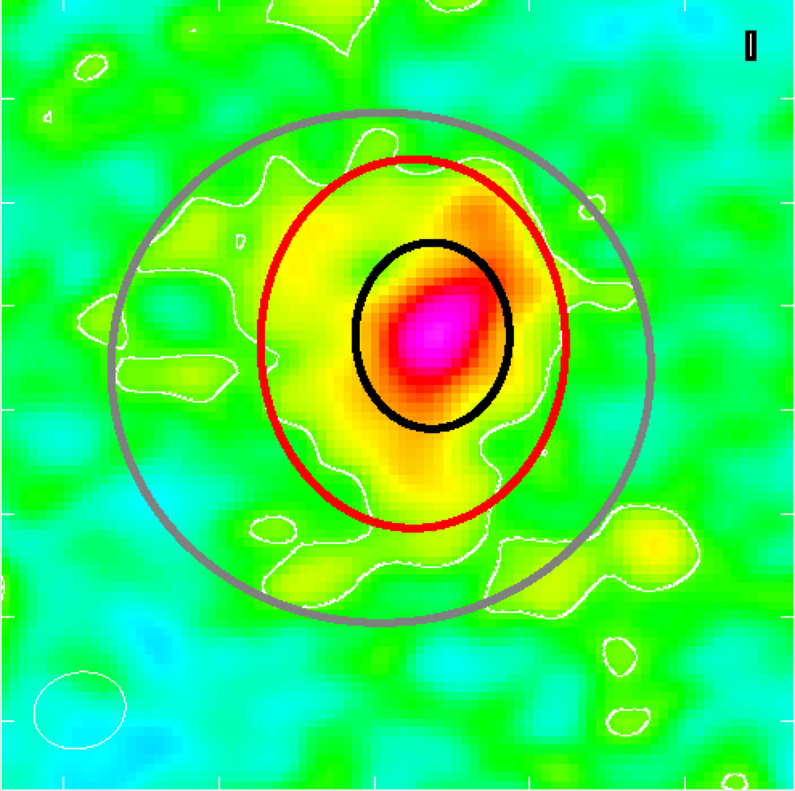
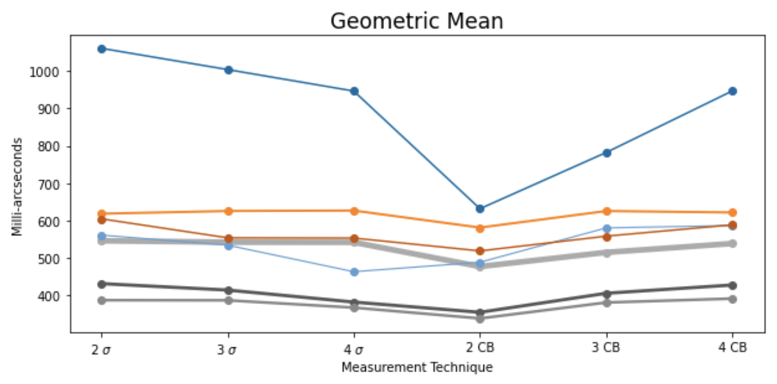
My Process
Different regions are proportionally sized to the amount of noise, in multiples of the RMS (𝞂), and the angular resolution (CB)
I fit each source with a 2D Gaussian
The clean beam
Notes:
Add residual? Five of the six methods yielded consistent results

Slide 6
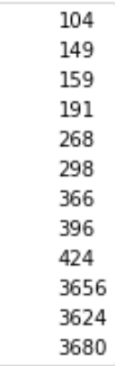
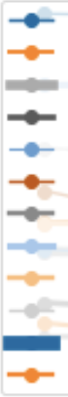
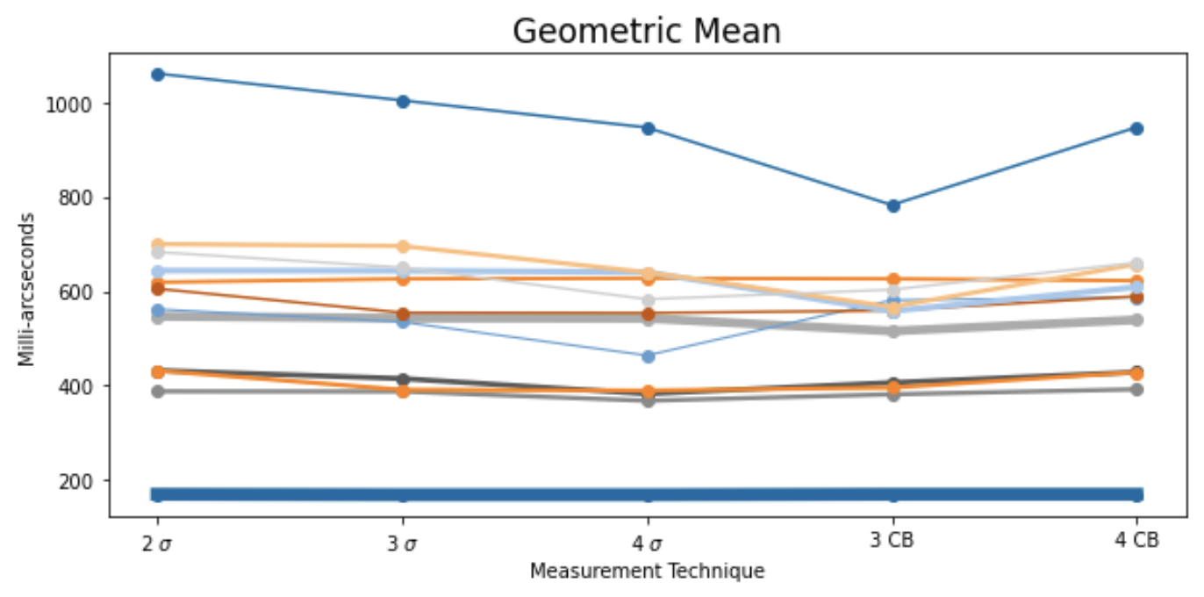
My Process
Different regions are proportionally sized to the amount of noise, in multiples of the RMS (𝞂), and the angular resolution (CB)
I fit each source with a 2D Gaussian
The clean beam
Notes:
Add residual? Five of the six methods yielded consistent results

Slide 7
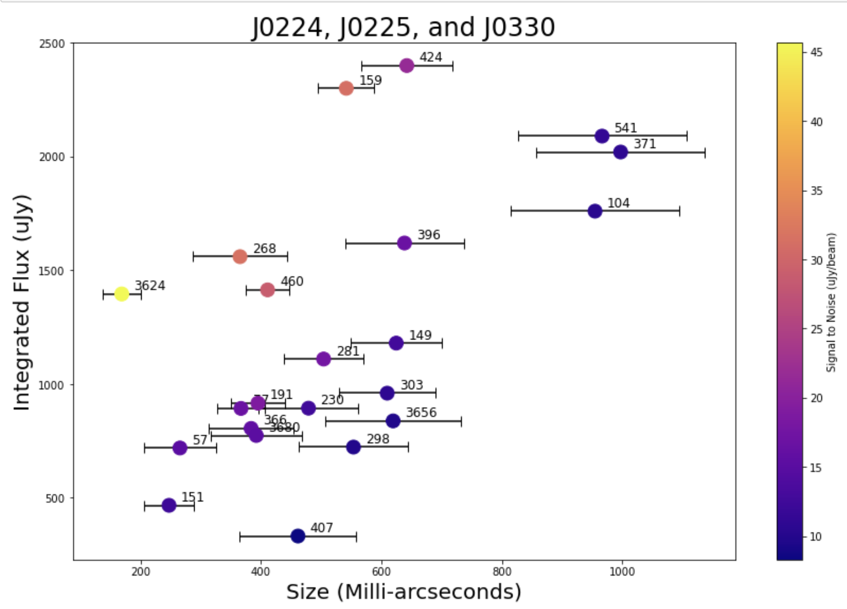
Results
Flux vs. Average Size for galaxies from three galaxy clusters:
J0224, J0225, J0330

Slide 8
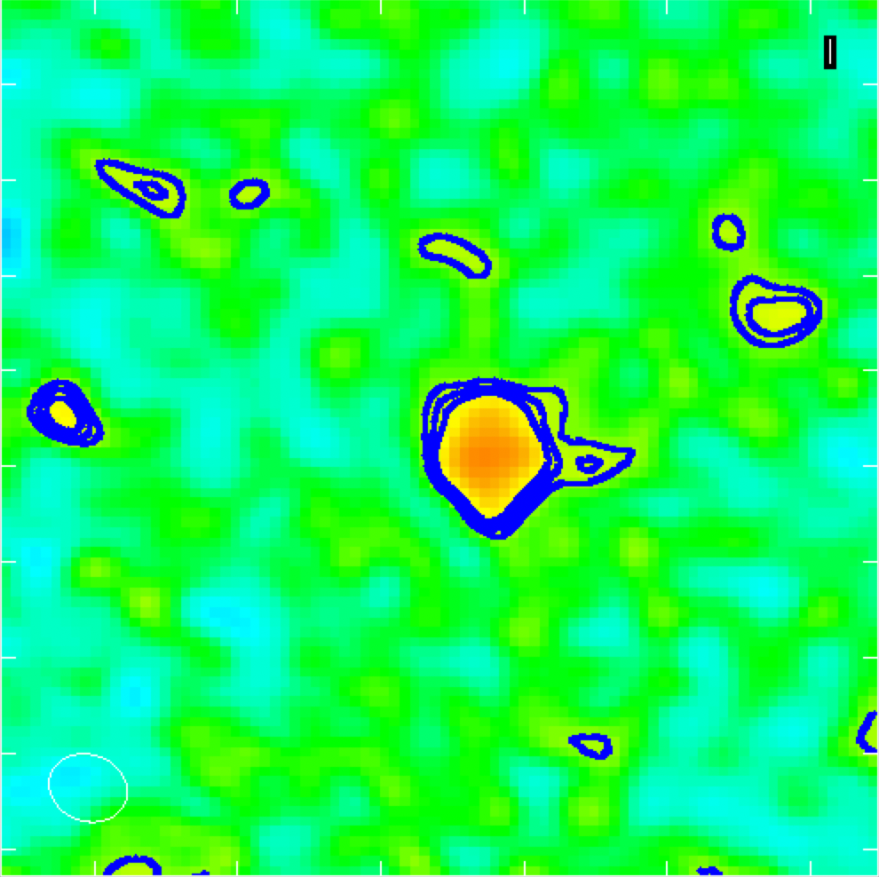
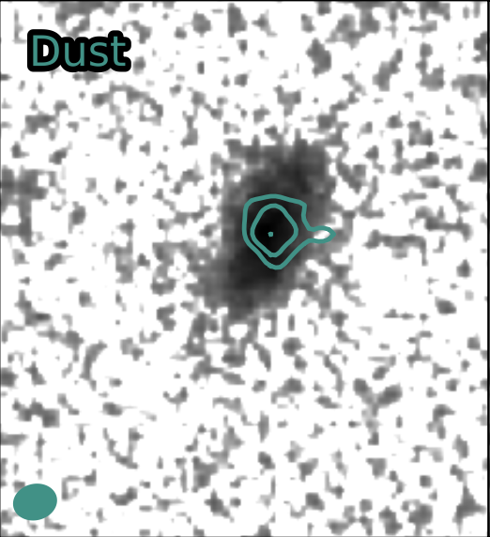
Future Work and Implications
Measuring galaxy models that replicate
the observing conditions of ALMA
Repeating measurements with each
galaxy’s gas component
Using residuals, we can identify unusual behavior, like ram-pressure stripping
Candidate for ram-pressure stripping

Slide 9
Thank You!

